Slide 1


Slide 2
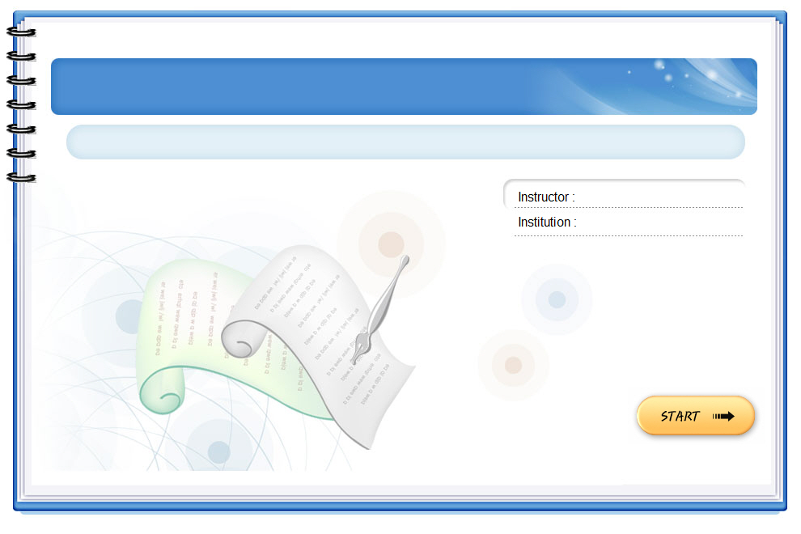
GAMES
Handicrafts
Brainstorming

Slide 3
traditional handicraft
drums
paintings
conical hats
marble sculptures
Handicrafts
Pottery
silk
lanterns
lacquerware

Slide 4
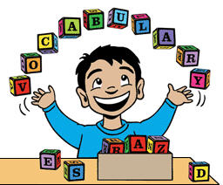
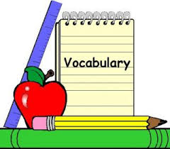
Unit 1 Local environment
Lesson 2: A closer look 1

Slide 5
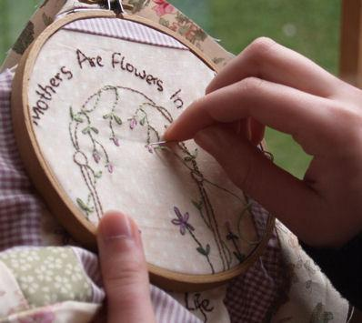
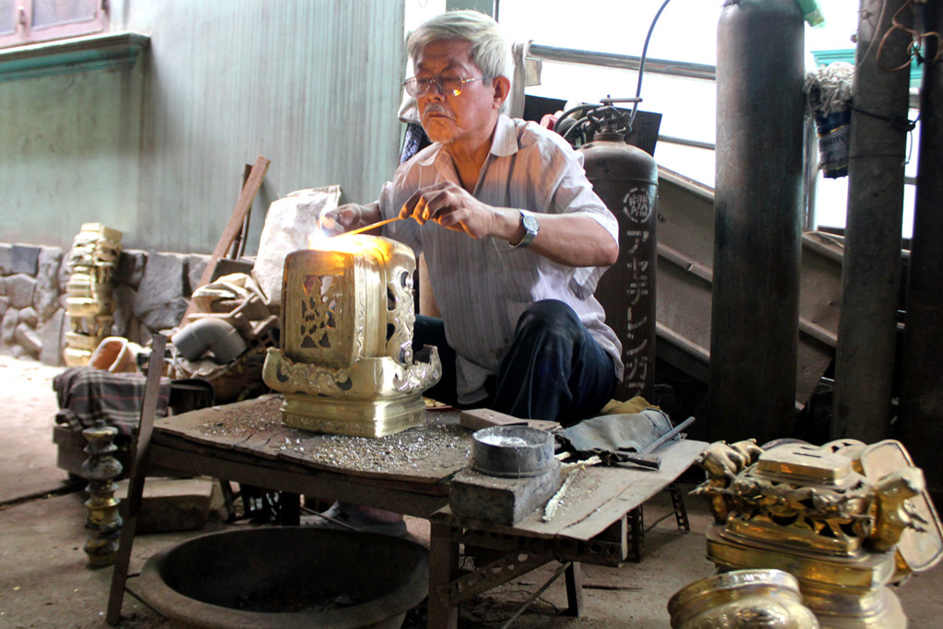
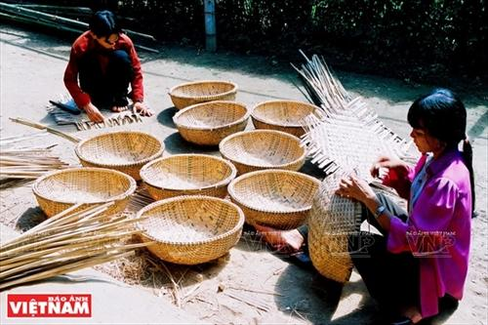
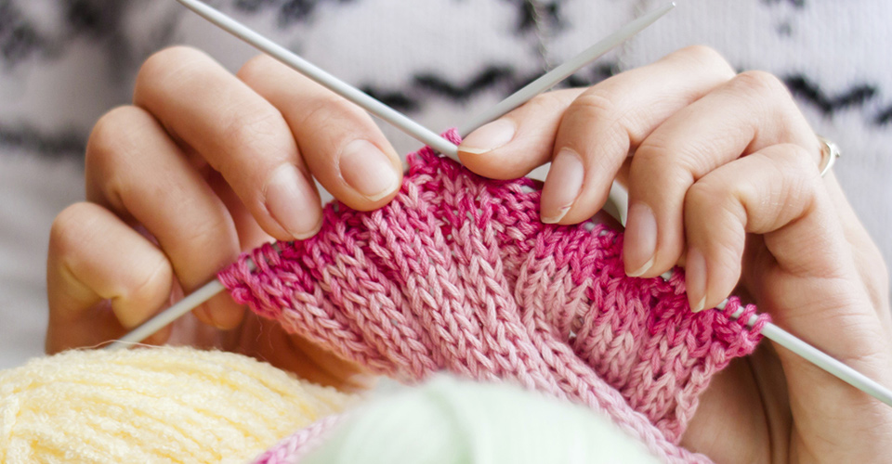
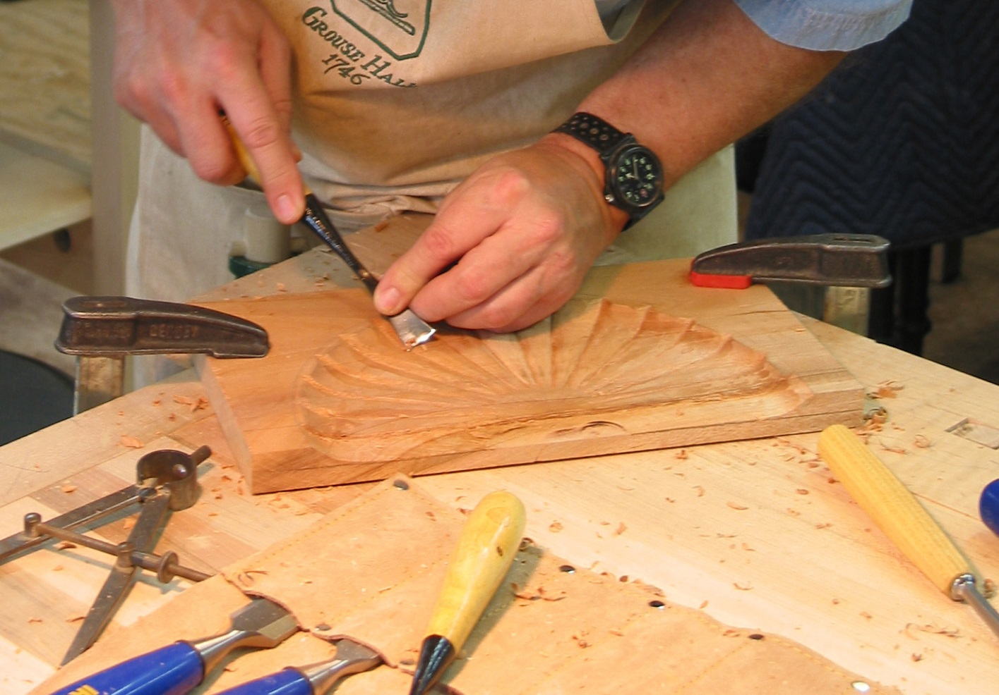
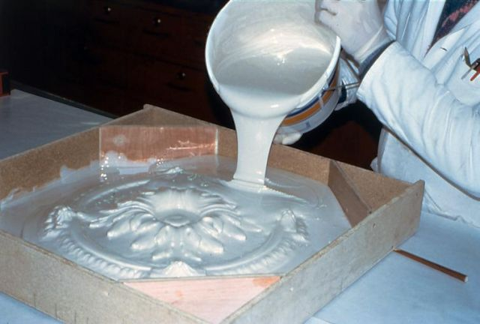
I. Vocabulary:
Carve [ kɑːv] (v):
Khắc, chạm, tạc, đục
Cast [kɑːst] (v):
Đúc, trải, sắp xếp
Weave [wiːv] (v):
Đan (rổ rá), dệt (vải)
Embroider [ɪmˈbroɪdə] (v):
Thêu
Knit [nɪt] (v)
Đan (len, sợi...)
Mould [məʊld]
Đổ khuôn, tạo khuôn

Slide 6

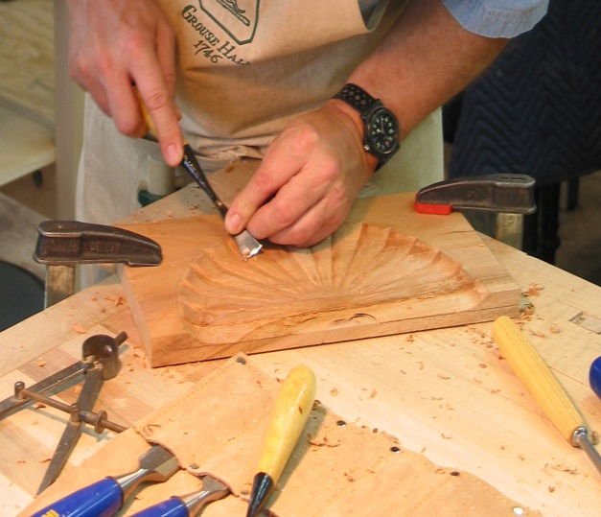
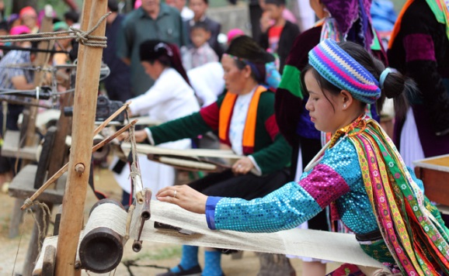

1. Match the verbs with the pictures
Carve
Cast
Weave
Weave
Embroider
Knit
Mould
A. .........................
B. .........................
C. .........................
D. ...................
E. ...................
F. ...................
G. ...................

Slide 7

carve
cast
embroider

Slide 8
cast
mould
carve

Slide 9
embroider
knit
weave

Slide 10
mould
knit
weave

Slide 11
cast
mould
carve

Slide 12
knit
weave
embroider

Slide 13
knit
cast
carve

Slide 14
2a. Match
A | B
1. Carve | a. handkerchiefs, tablecloths, pictures
2. Cast | b. stone, wood, eggshells
3. Weave | c. clay, cheese, chocolate
4. Embroider | d. bronze, gold, iron
5. Knit | e. baskets, carpet, silk, cloth
6. Mould | f. sweaters, toys, hats

Slide 15
2b. Match the verbs in column A with the group of nouns in column B
Infinitive | Past tense | Past participle
1. to carve | I carved it. | It was carved.
2. to cast | I ...................... it. | It was ......................
3. to weave | I ...................... it. | It was ......................
4. to embroider | I ...................... it. | It was ......................
5. to knit | I ...................... it. | It was ......................
6. to mould | I ...................... it. | It was ......................
cast
cast
wove
woven
embroidered
embroidered
knitted
knitted
moulded
moulded

Slide 16
3. Places of interest
Entertaining
- cinema
Educational
- library
Places of interest
Cultural
- Opera house
Historical
- building

Slide 17
4. Complete the passage by filling suitable words.
attraction
historical
traditional
handicrafts
culture
exercise
Some people say that a place of interest is a place famous for its scenery or a well-known (1) .............................. Site. I don’t think it has to be so limited. In my opinion, a place of interest is simply one that people like going to.
In my town, the park is a(n) (2) ................................ because many people love spending time there. Old people do (3) ........................... and walk in the park. Children play games there while their parents sit and talk with each other. Another place of interest in my town is Hoa Binh market. It’s a(n) (4) ............................ market with a lot of things to see. I love to go there to buy food and clothes, and watch other people buying and selling. Foreign tourists also like this market because they can experience the (5) ............................ of Vietnamese people, and buy woven cloth and other (6) ................................. as souvenirs.

Slide 18

Pronunciation

Slide 19
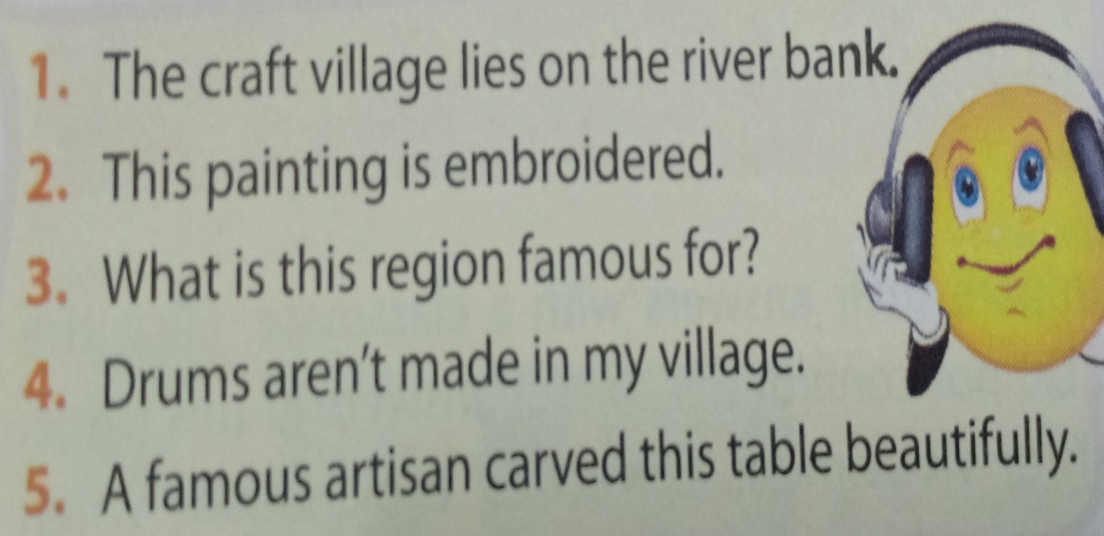

5a. Listen then answer the questions.
1. Which words are louder and clearer than the others?
2. What kinds of words are they?
3. Which words are not as loud and clear as the others
4. What kinds of words are they?

Slide 20
5a. Answerkey
1. Which words are louder and clearer than the others?
1. craft, village, lie, river bank
2. painting, embroidered
3. What, region, famous
4. drums, aren’t, made, village
5. famous, artisan, carved, table, beautifully
2. What kinds of words are they?
They are: nouns, verbs, adjective, adverbs, wh-question words, and negative auxiliaries.
3. Which words are not as loud and clear as the others
2. this, is
3. is, this, for
1. the, on, the
4. in, my
5. a, this
4. What kinds of words are they?
They are: articles, prepositions, pronouns, and possessive adjectives.

Slide 21
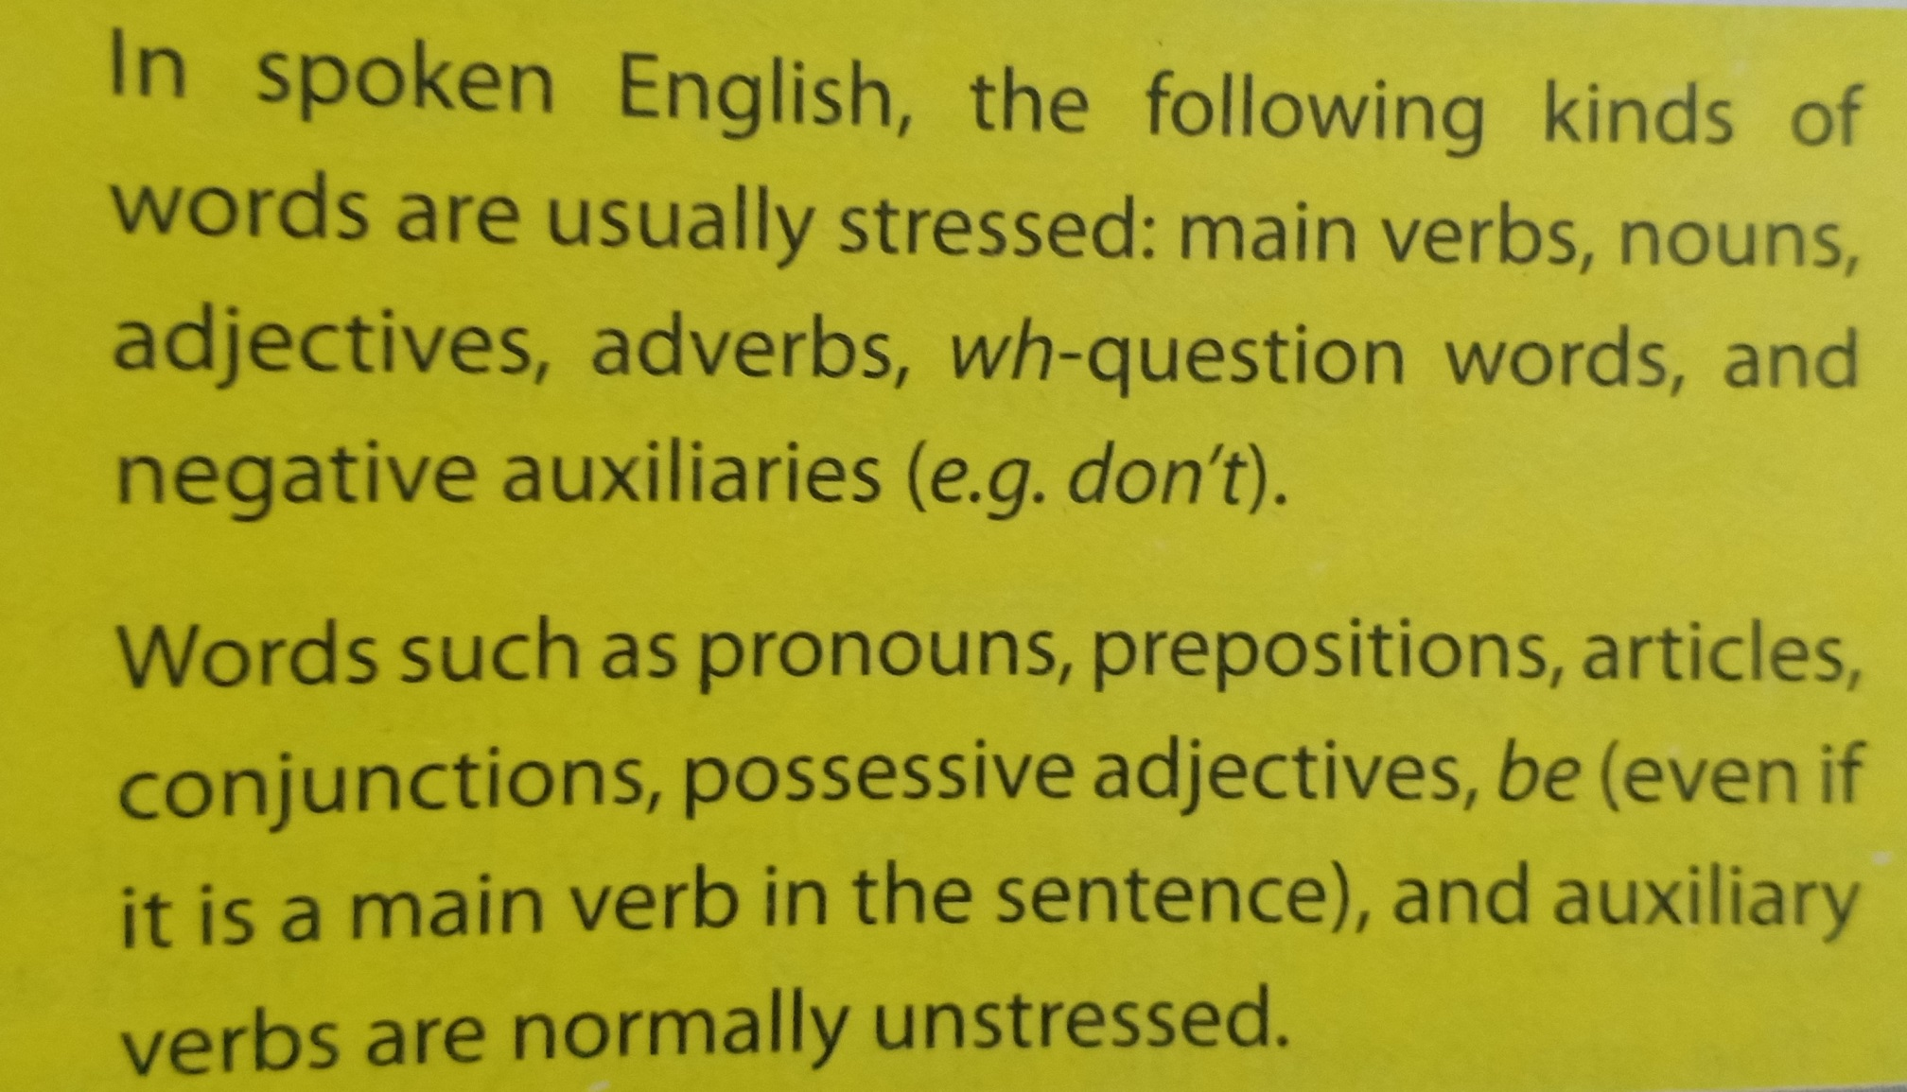
Remember

Slide 22
6. Underline the content word in the sentences.
1. The Arts Museum is a popular place of interest in my city.
2. This cinema attracts lots of youngsters.
3. The artisans mould clay to make traditional pots.
4. Where do you like going at weekend?
5. We shoudn’t destroy historical buildings.

Slide 23
HOMEWORK
Write newwords.
Prepare lesson 3: A closer look 2
Do exercises in workbook.
See you next time

Slide 24


